Slide 1

Web Books
Sell Purchase Donate
Submitted by :-
Shiv Mangal
Om Prakash Jha
Hemnandan Kumar
Submitted To :-
Dr. Rekha Kashyap

Slide 2

Contents
Introduction
Real World Scenario
Problem description
Literature survey
Questioning and Comparison
Possible solutions
Our Approach
Advantages and Disadvantages
Feasibility study
References

Slide 3



Introduction
Providing User a clean User-friendly and a specific E-commerce Website that focuses on one single class of product that is Book.

Slide 4
Real World Scenario
There are various websites that offer selling books but these are not for specifically for books (major ones like amazon, flip kart, eBay).
Our objective is to make a clean and user-friendly website only for books.

Slide 5
Problem Description
So what is the actual problem
Everyone Focuses on novels(Most Of Them).
There are very less option for used books.
No Body Focus on Donations.
No book rental services Found
EBook like kindle services are not affordable

Slide 6




Literature survey
There are a lot of websites on internet whereby it offers a variety of product and services for consumer can find and buy through online. In this research we will develop an e-commerce website that offer sell purchase and donation books to different consumer.

Slide 7
Possible solutions
So Here is the Possible solutions
We will add educational books
A section for used books.
More Focus on Donations.
Providing book rental services.
affordable EBook service.

Slide 8
Our Approach
Sales :- website should at least be generating sales and/or quality leads.
Customer Service :- website can offer or improve customer service. For example, frequently asked questions and contact details.
Community :- Website provide platform to contribute in community.

Slide 9
Advantages and Disadvantages
Advantages
Customers can get their book delivered instead of actually going and buying the book.
This system saves both time and travelling cost of customers.
User can get to know different kinds of books that they were unaware of by just searching in the system using keywords.
Disadvantages
System may provide inaccurate results if data no entered correctly.

Slide 10
Feasibility study
Technical feasibility
This can be achieved using latest technology and hardware for our project
Financial feasibility
Since this is a College project So initial investment is put to low such that the project is financially feasible.
Market feasibility
This Project meets all the requirements of competitors in market
Organizational feasibility
All rights and credit Goes to actual owners and copy right holders.

Slide 11
References
https://www.amazon.in/
https://www.flipkart.com/
https://www.flipkart.com/
https://www.bookchor.com/
https://www.bookthela.com/
https://books.google.co.in/

Slide 12
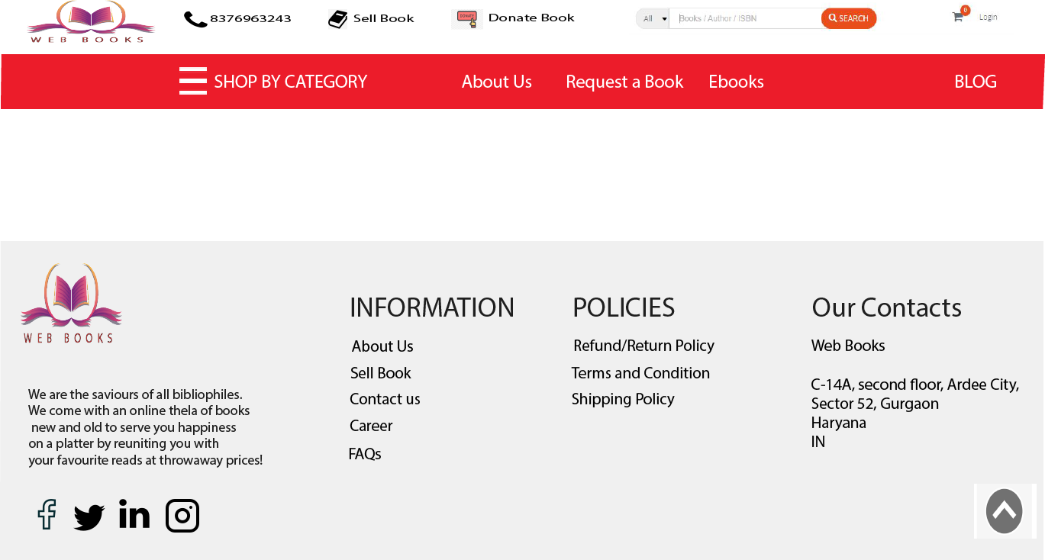

Slide 13
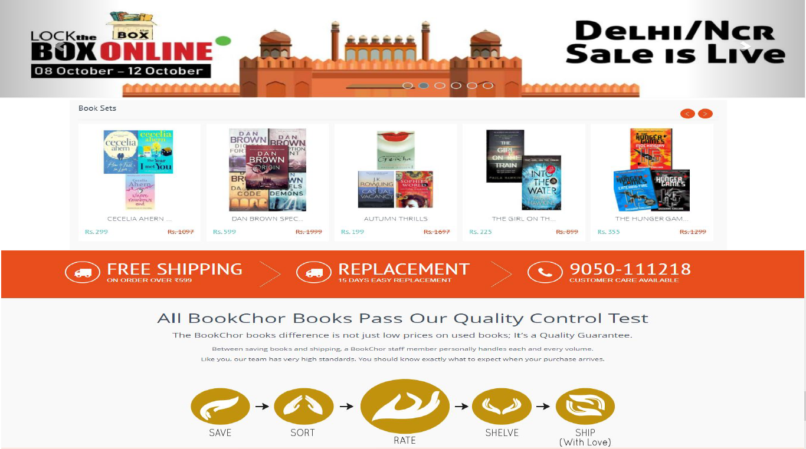

Slide 14

Questioning

Slide 15
Thank You

